Slide 1
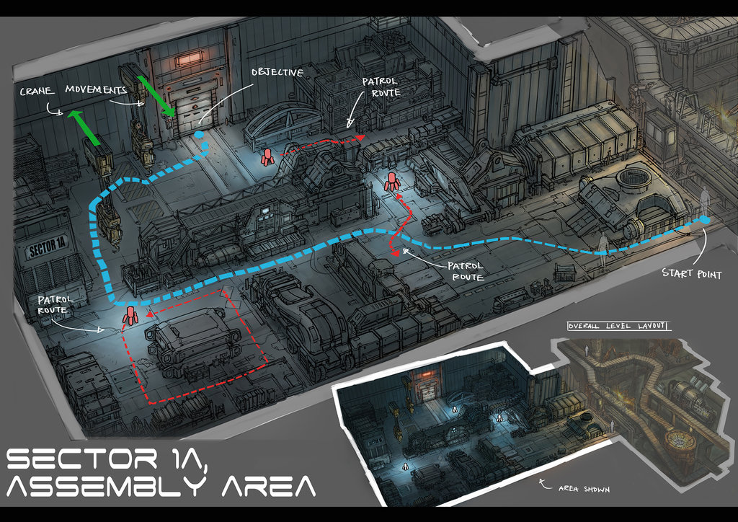
LEVEL DESIGN I
MA. Marcel Casarini

Slide 2
About me:
Charles Cue
Game Designer, Programmer, Technical Designer since 2011
Instructor for 10+ years
JRPG, Mystery, Rhythm games

Slide 3
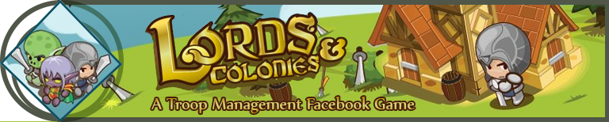

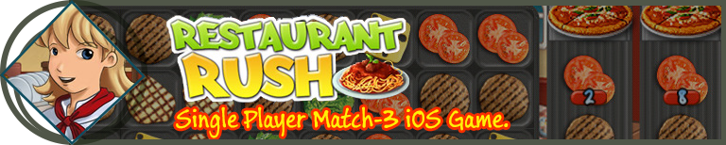

My games:

Slide 4
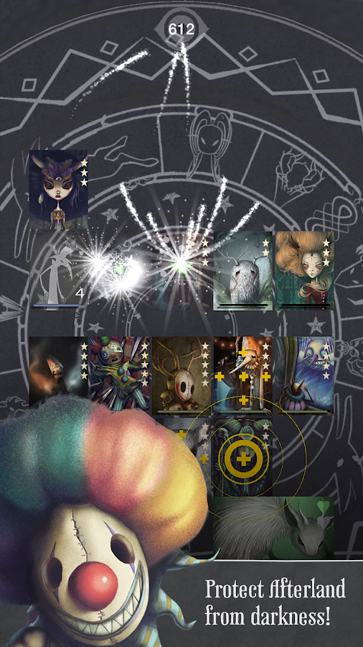
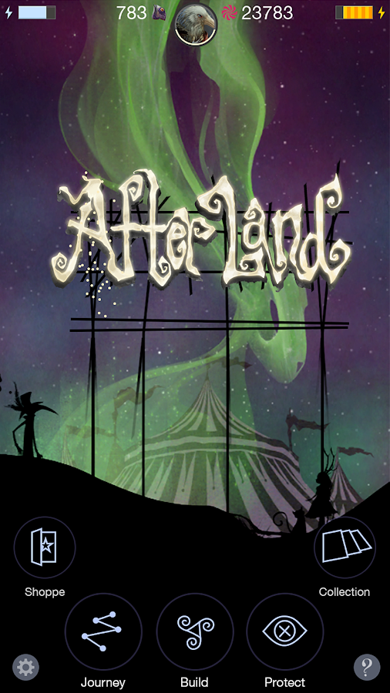
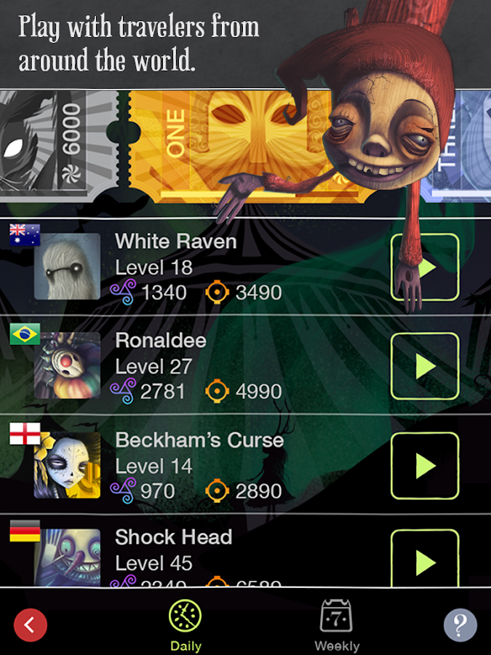
My games:

Slide 5

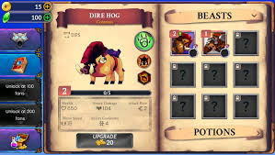
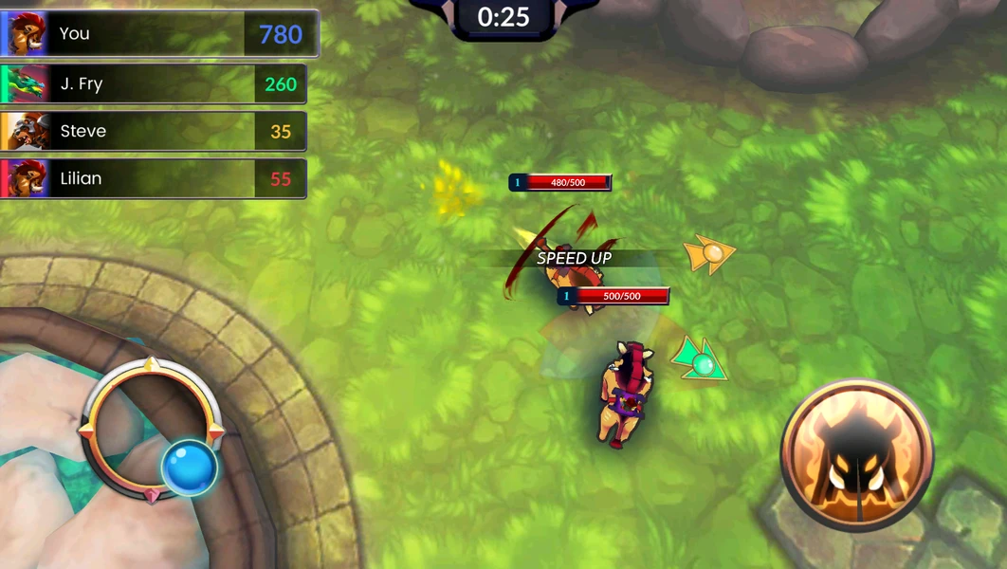
My games:

Slide 6
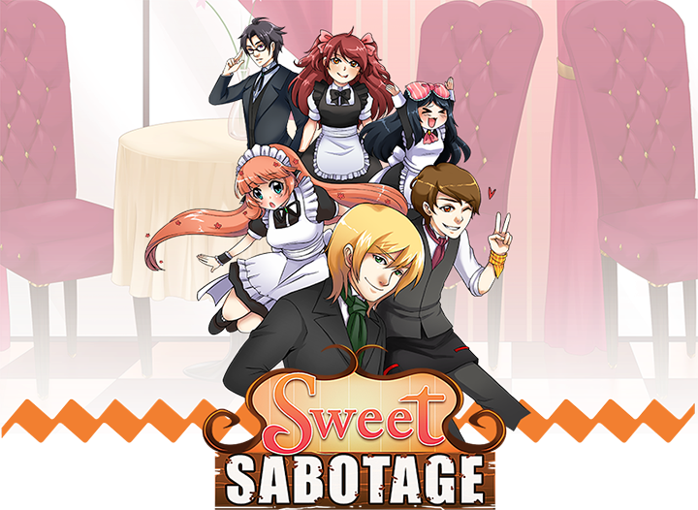
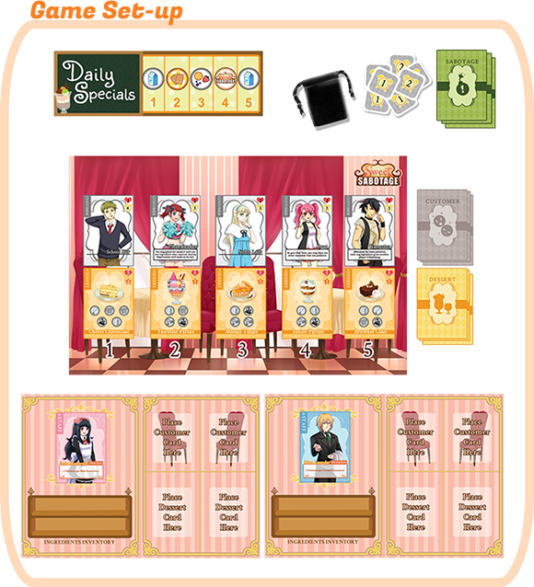
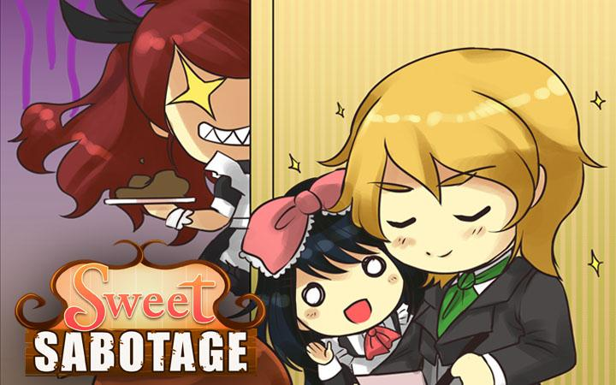
Our Original IPs:

Slide 7

About you:
Name;
Program;
Favorite genre;
Favorite game/franchise;
Playing now;

Slide 8


I am acting as your boss;
You will be evaluated as a professional;
I expect ownership and proactivity;
This is a Job!

Slide 9

This is Your Job!
GT – Try always to exceed the expectations (mine and yours).

Slide 10
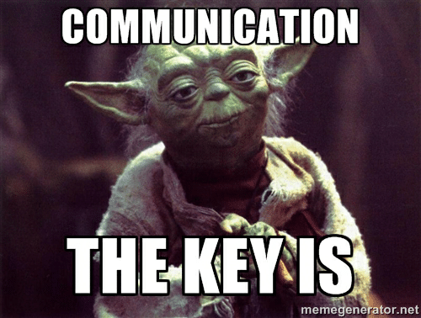
Also, speak up!
I want to hear your comments and questions!

Slide 11

What is level design?
Is the intentional creation and generation of specific gameplay situations, game dynamics, and gameplay moments by carefully incorporating game mechanics and presentation content, into a carefully organized space.
You can use level design to improve every aspect of the game such as:
Narrative;
Mechanics;
Art;
Flow and pacing;

Slide 12
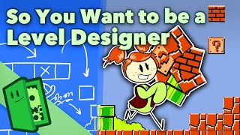
WHAT IS LEVEL DESIGN

Slide 13
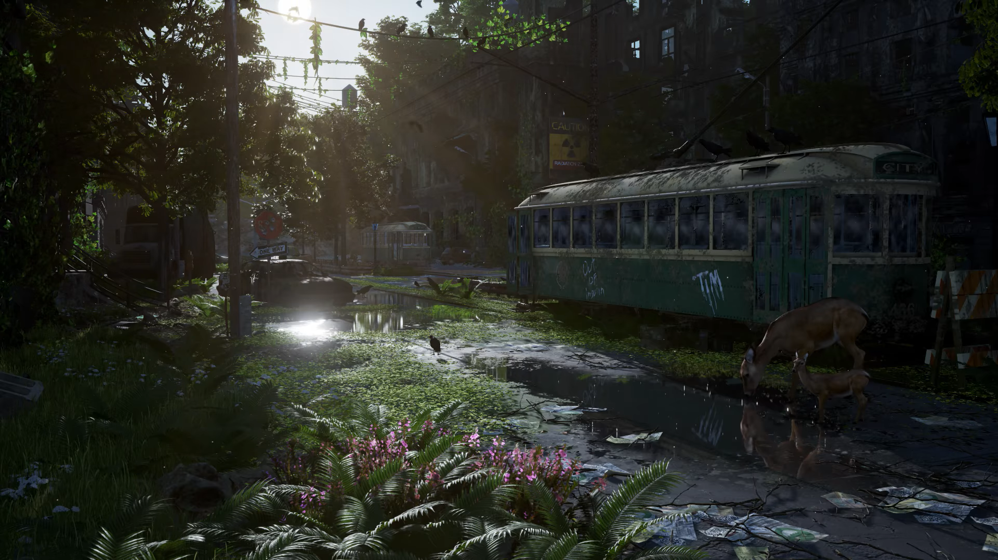
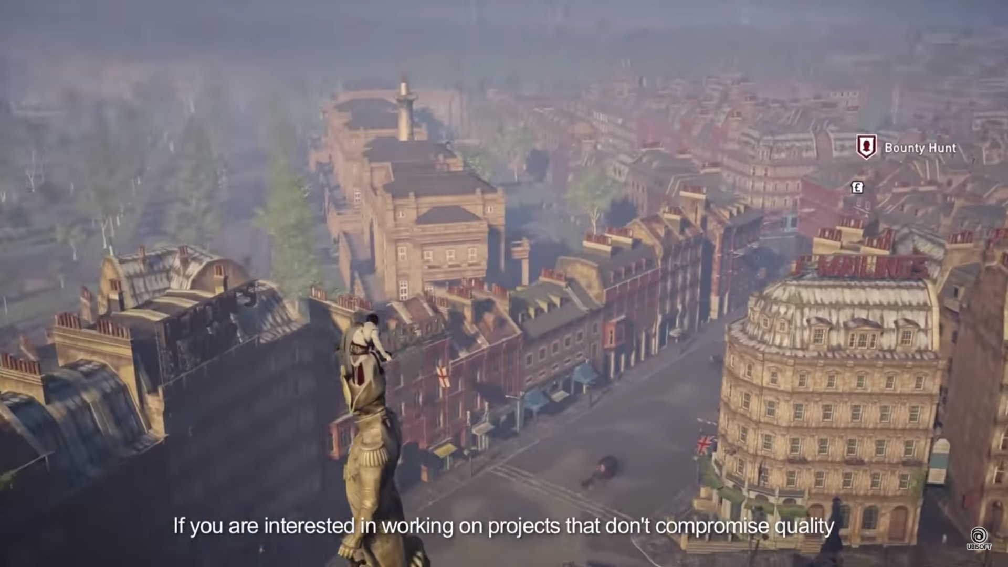
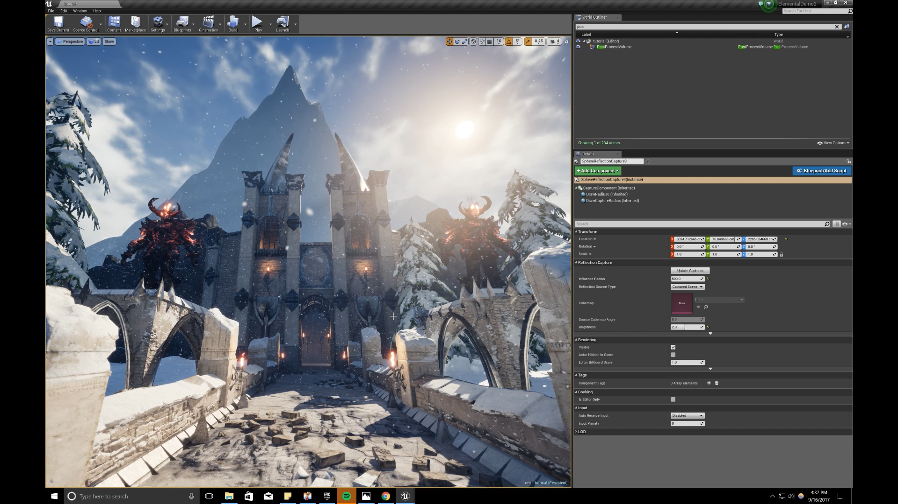
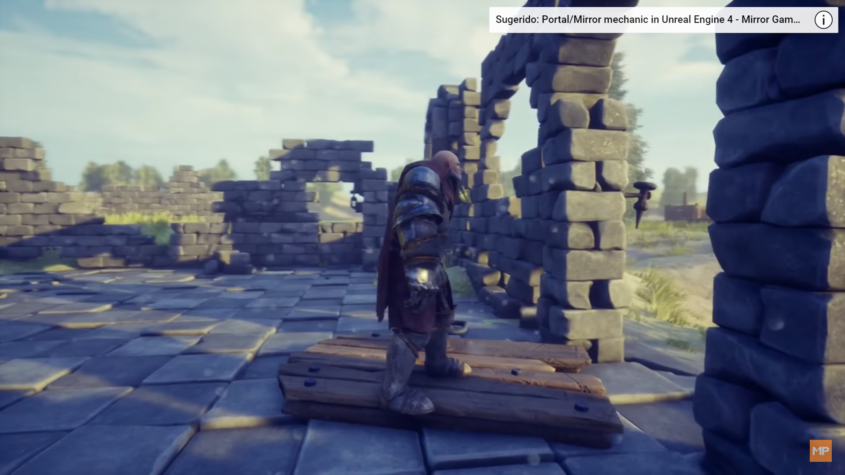
Is this level design?

Slide 14
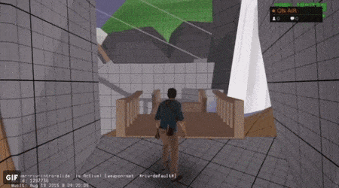
This is level design!
GT – Level design is all about the experience.

Slide 15

CORE CONCEPTS

Slide 16
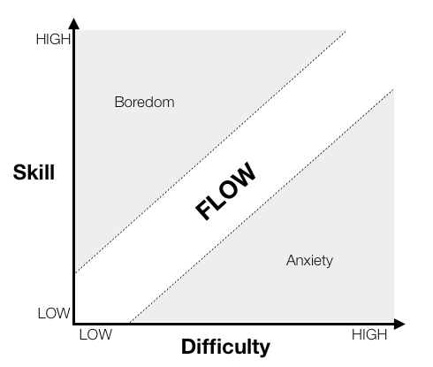
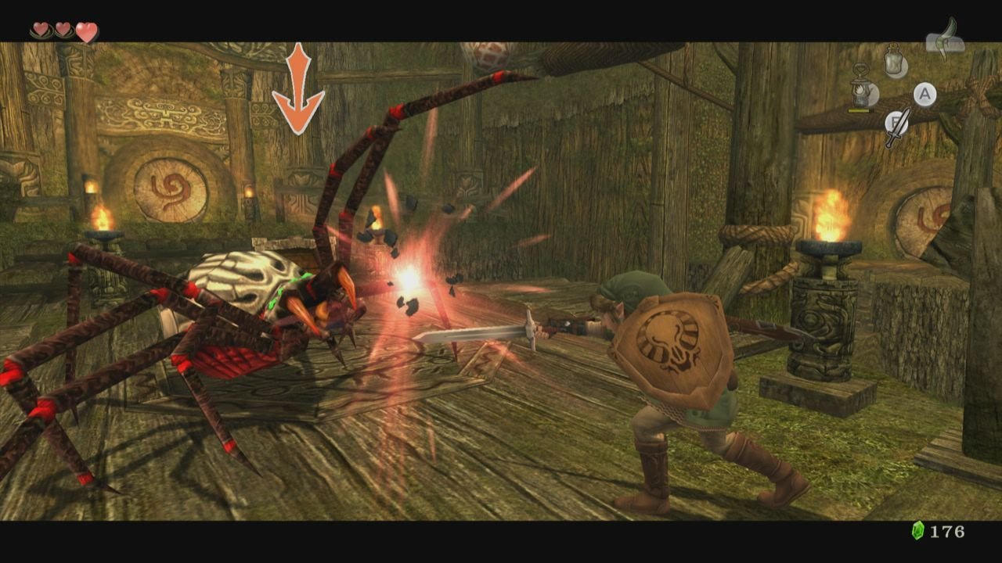
Game Flow/Pacing
Flow is what make the game fun. If well tuned, can transform even the simplest tasks into something interesting.
As level designers we are in charge of making the flow feel right room by room.

Slide 17
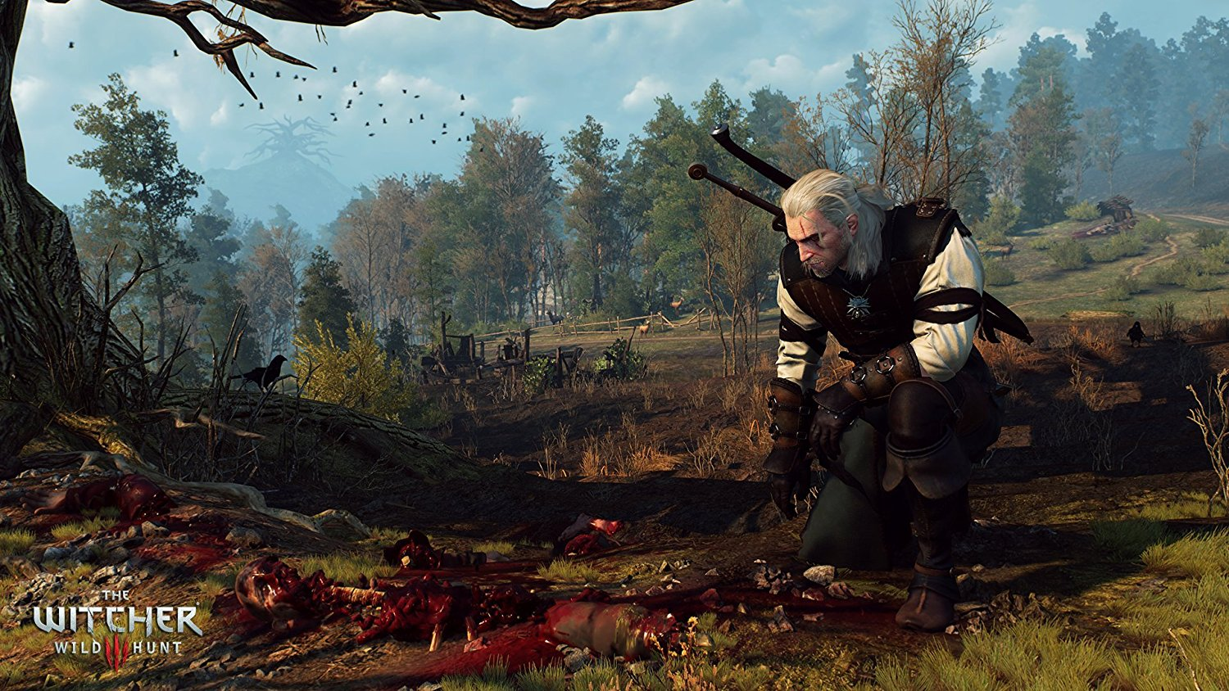
A level design is basically the space and events where your game mechanics will take place.
Navigation
The best way to understand a place is by exploring it. This is NAVIGATION.
Notes:
We use the camera inside a 3D environment to project it in to a 2D screen. This language came from the movies.
Give the example of visualizing 3D objects in a 2D screen. The only way to understand the depth is by moving the camera around.

Slide 18
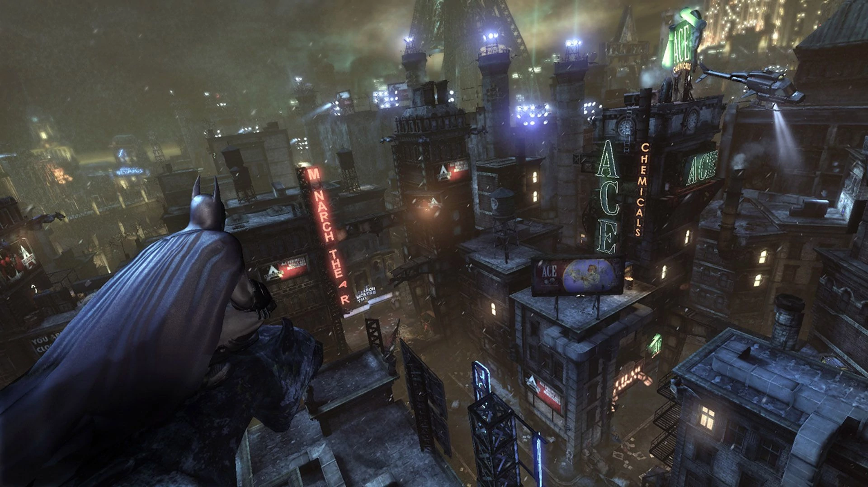
Navigation
The player navigate through the hollow spaces in the level, so they are as important as the filled spaces.
Always think about witch routes you are providing to your player and try to make each one interesting in its own way.
Notes:
We use the camera inside a 3D environment to project it in to a 2D screen. This language came from the movies.
Give the example of visualizing 3D objects in a 2D screen. The only way to understand the depth is by moving the camera around.

Slide 19
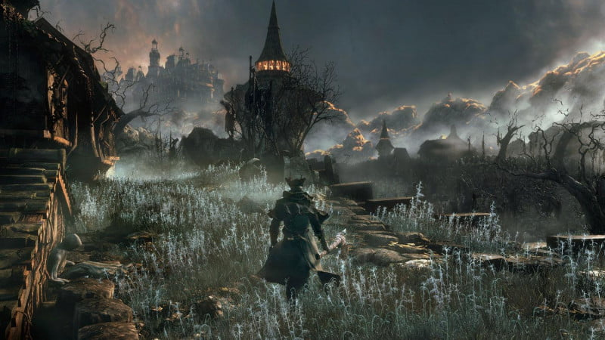
Orientation
In order to understand where they are, we must provide clues for the orientation.
Landmarks are the best way to do it.
Notes:
Diegetic non diegetic

Slide 20

Wayfinding
Waypoints are necessary to guide the player.
We can use landmarks, colors, lighting, enemies, movement or VFX.

Slide 21
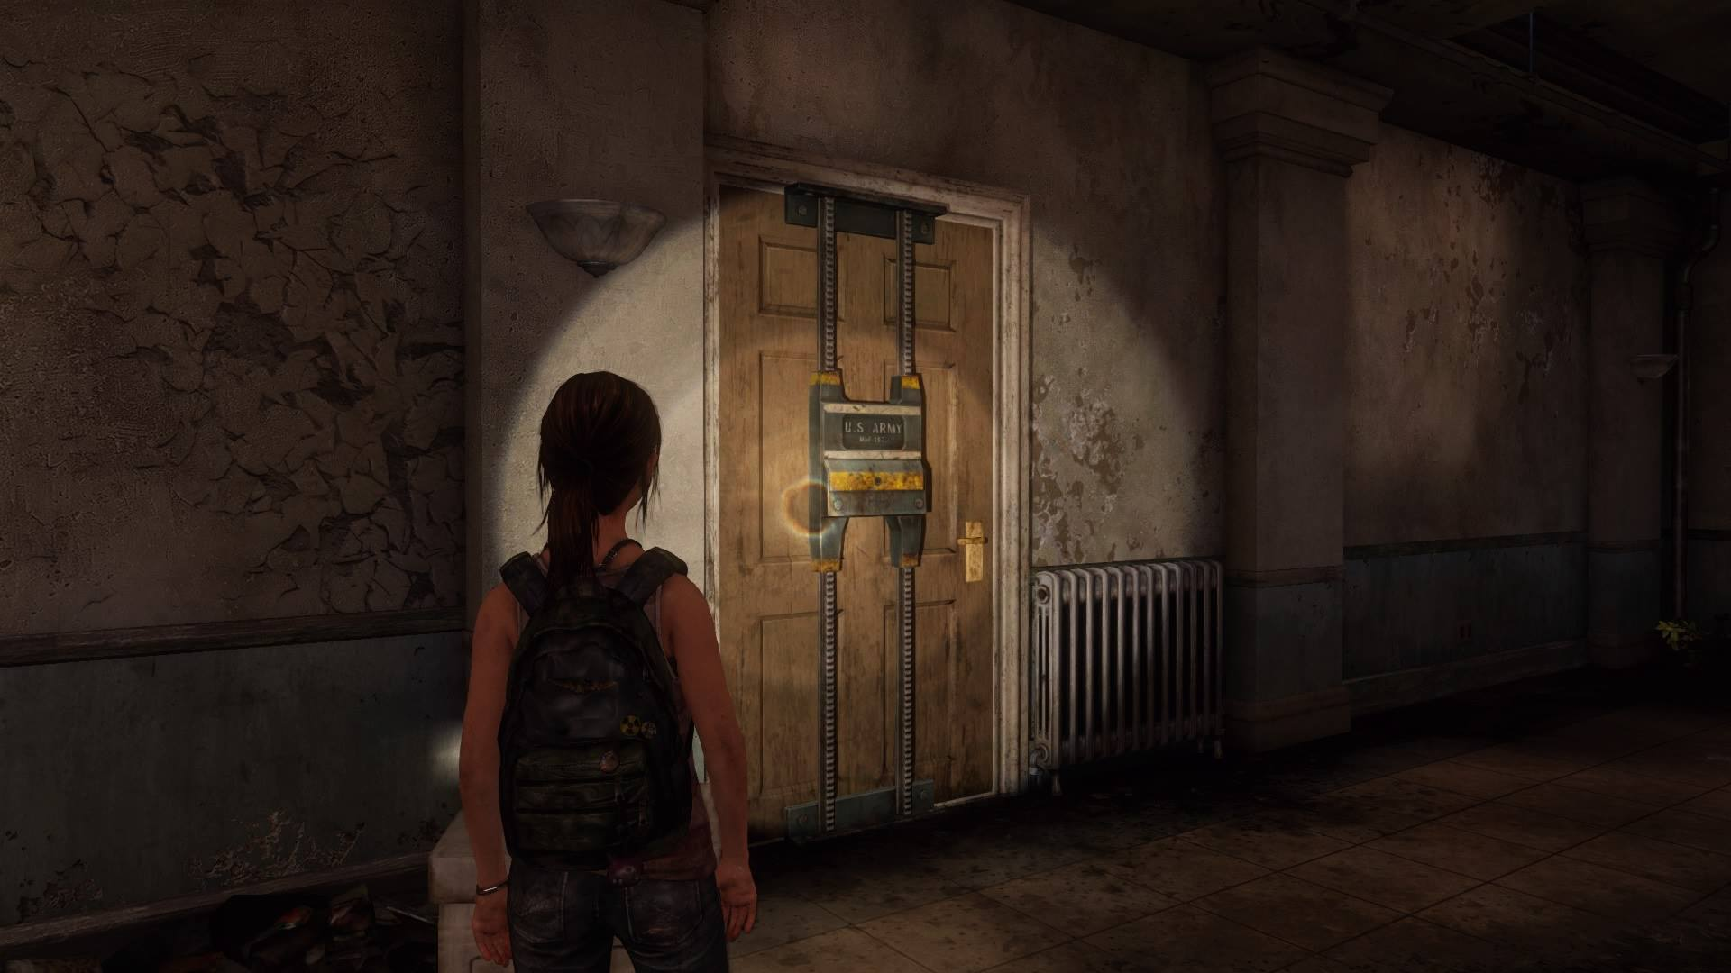
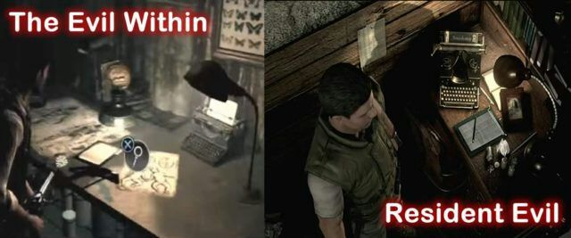
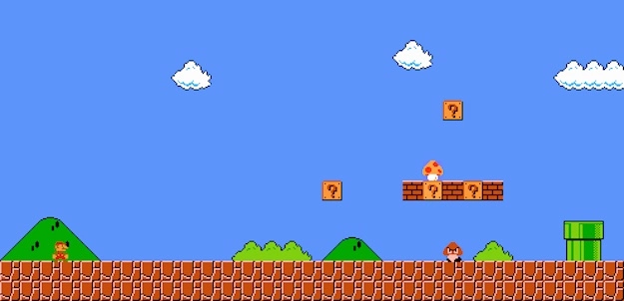
If a door is closed or not. Could you enter it later?
Typewriter - you’re safe, and you can save
? block = Something interesting is inside
Signifiers
Signifiers are visual cues in the game that communicate things to the player. They send a message.

Slide 22
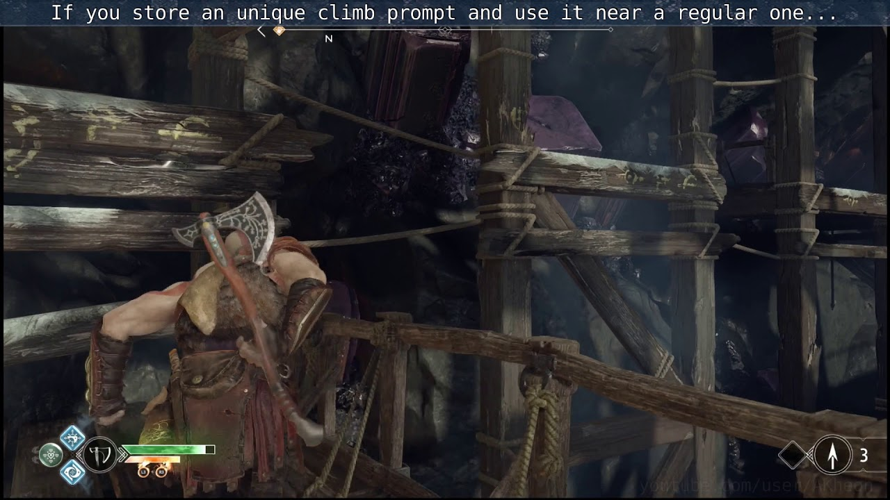
Players will draw those associations taught in the tutorial (safe space) when they play through the rest of the game.
Signifiers

Slide 23
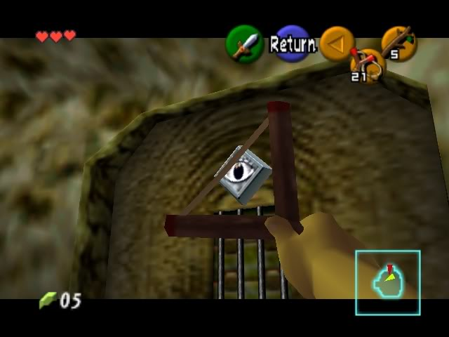
Affordance
These things are often relatable to real-world things.
Affordances are when a player knows how to use something - things in a game where its form implies function.

Slide 24
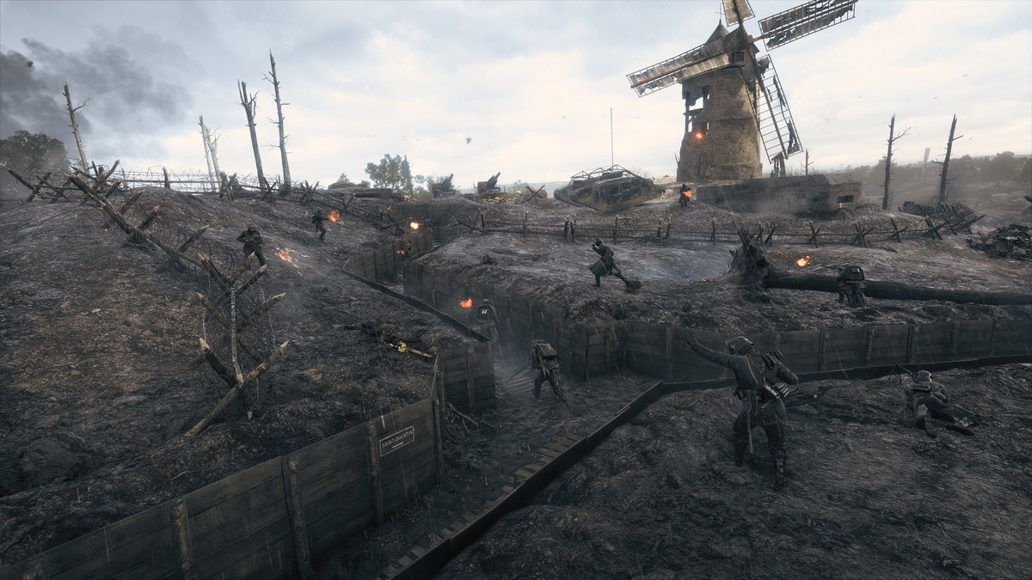
Are especially important for shooters.
http://level-design.org/?page_id=2274
You must provide variations in order to create different combat encounters.
Sightlines

Slide 25
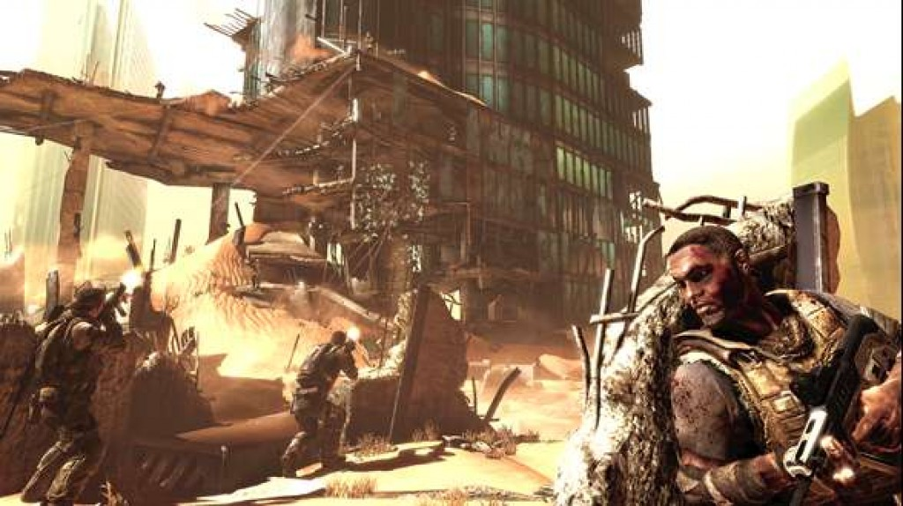
Full - Completely hides the character when standing
Half - Only covers half the character when standing
Some half cover may act as full cover when crouched in some games
Partial - May be less than full cover such as Half or less
Could be used to also discuss semi-transparent cover
http://level-design.org/?page_id=2274
Full Cover
¾ Cover (Partial)
Half Cover
Cover

Slide 26
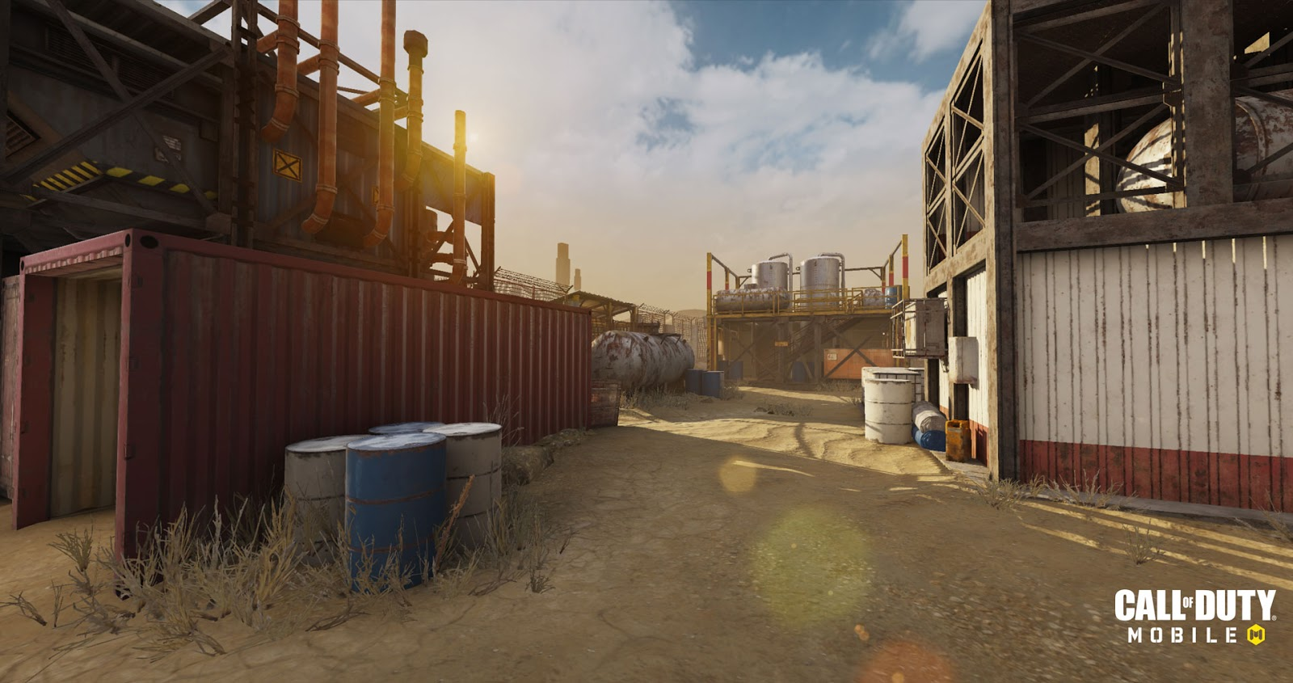
The distance at which you maintain accuracy and damage capabilities
Exact ranges depend on the game, here are some general examples:
Close - Within ~1m of the player
Short - Between ~1-5m of the player
Mid - Between short range and about 3x that distance
Long - Beyond Mid range
Different weapons are better suited to different ranges
Design spaces to encourage encounters at different ranges
http://level-design.org/?page_id=2274
Short (1-5m)
Medium
(10-15m)
Long
(15+m)
Range

Slide 27
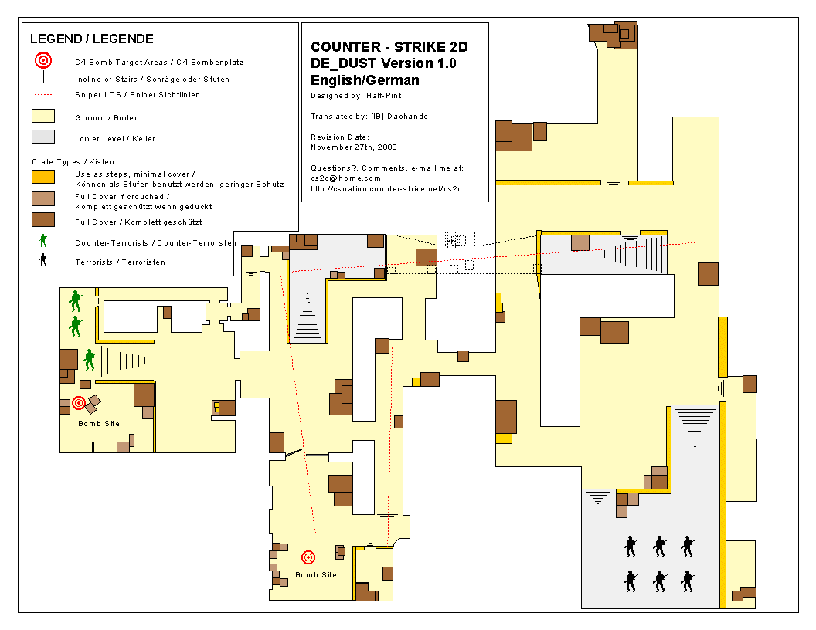
The viewing line from a particular vantage point
Rules of thumb:
Too limited of sight lines can create a cramped feeling and can easily disorient players
Areas with long sight lines are ideal for long range weapons, but can create unwanted behaviour (camping)
Sight lines should ideally be used to both lead the player, and create conflict choke points
http://level-design.org/?page_id=2274
Lines of Sight

Slide 28
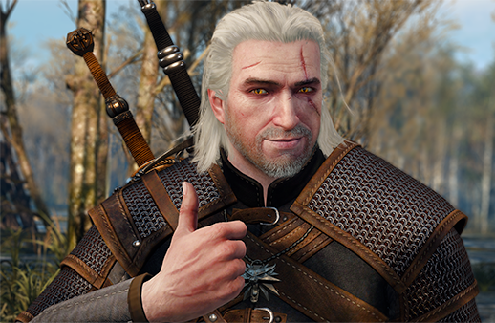
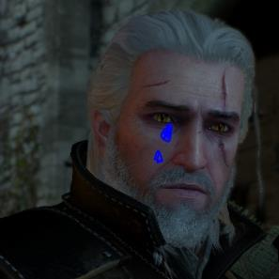
Assignment 1
QUEST 1
Extra:
Play / Watch RIME.

Slide 29
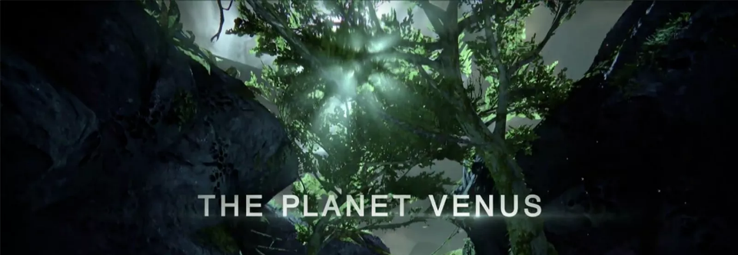
GAD130
LEVEL CHARACTERISTICS
Type: Crucible – Team Competitive Multiplayer
Mode: Control – Base capture
Planet: Venus

Slide 30
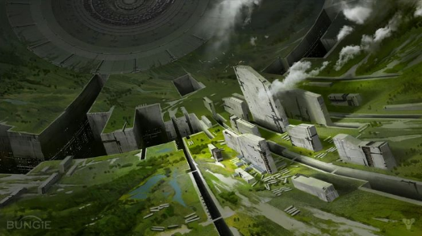
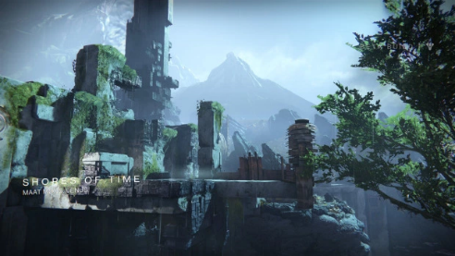
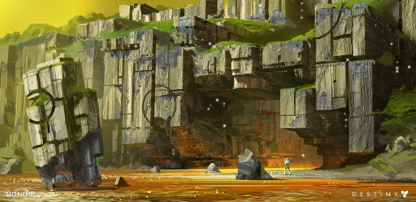
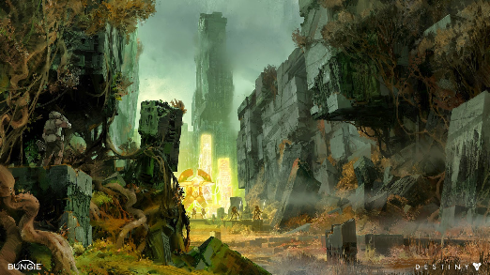
ART STYLE
Research

Slide 31
ART STYLE
Research
CUBIC SHAPES

Slide 32
ART STYLE
Research
VEGETATION / STONES / METAL

Slide 33
ART STYLE
Research
CIRCULAR DETAILS

Slide 34
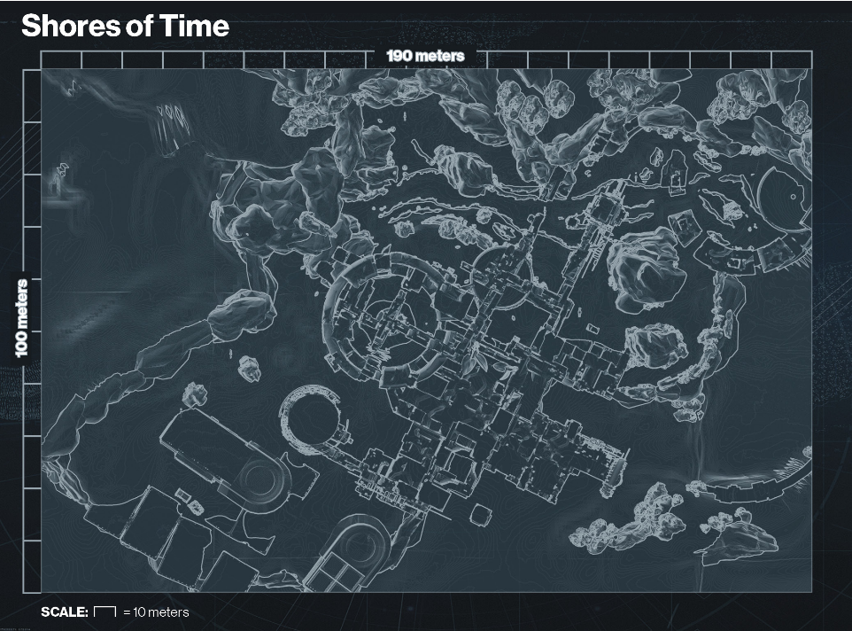
LEVEL REFERENCE

Slide 35
LEVEL REFERENCE
LEVEL FORMS AND SCALE

Slide 36
LEVEL REFERENCE
SPAWN AREAS

Slide 37
LEVEL REFERENCE
CAPTURE ZONES

Slide 38
LEVEL REFERENCE
SPECIAL AMMO

Slide 39
LEVEL REFERENCE
SPECIAL AMMO

Slide 40
LEVEL REFERENCE
HEAVY AMMO

Slide 41
LEVEL REFERENCE
COMBAT ZONES

Slide 42
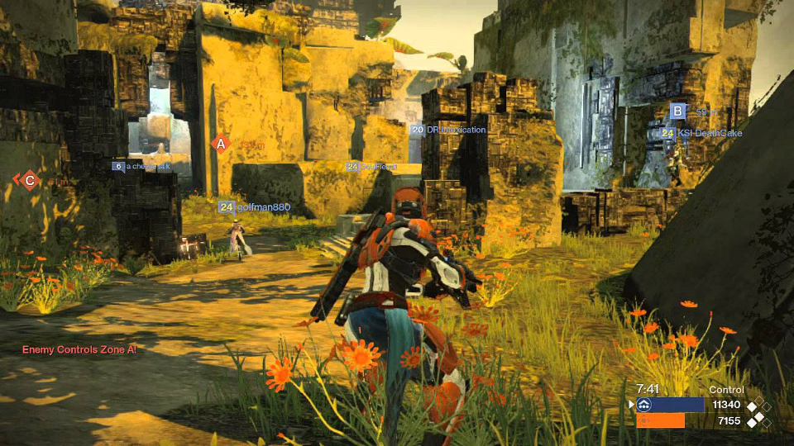
LEVEL REFERENCE
The cubic shapes can be used as a nest or as an advantage point

Slide 43
LEVEL REFERENCE
It is used as an obstacle for long aiming

Slide 44

Additional Resource (Preview for Week 2):
4-Step Level Design

